Slide 1
Signal conditioning

Slide 2
Signal conditioning
manipulation of the input measurement
improve controller performance
Many types
Instrument linearisation
Process linearisation
Pressure compensation
Filtering
...
Notes:
Signal conditioning is manipulation of the input measurement to (or output signal from) a controller. It may be required to compensate for nonlinear behaviour.
A mathematical function is applied in order to improve controller performance.

Slide 3
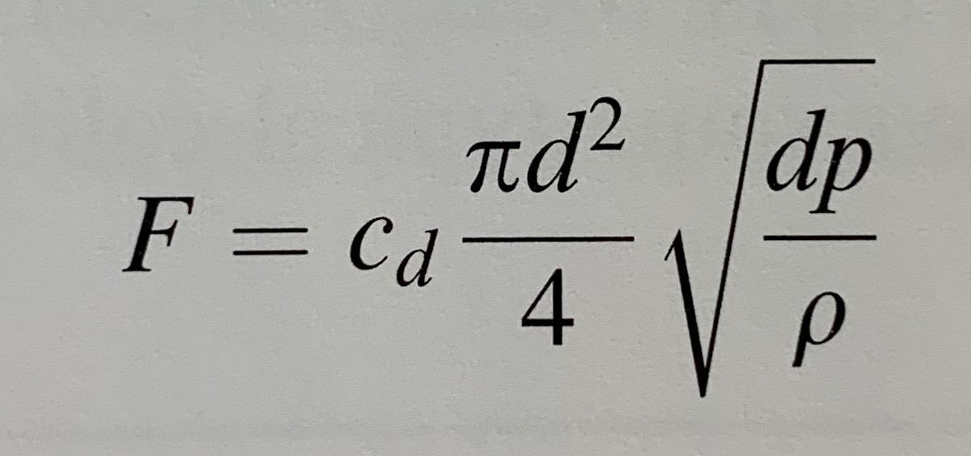
Instrument linearisation
most frequent application
example - melted metal flow
F - flow through orifice
cd - discharge coefficient
d - orifice diameter
dp - pressure drop across orifice
ρ - fluid density
Notes:
The most frequent application of signal conditioning is linearisation. Let’s look at the example of melted metal flow through the orifice.

Slide 4
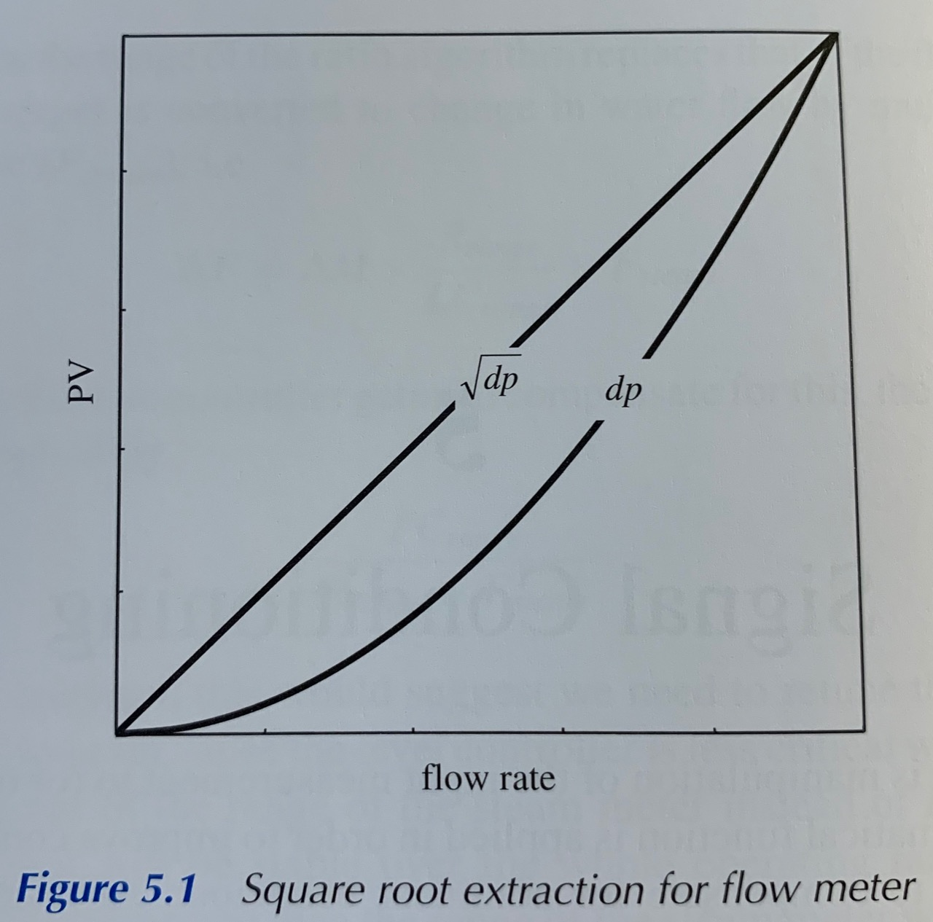
Instrument linearisation
We want to ensure that there is a linear relationship
between dp and flow
Notes:
The flow can therefore be measured by measuring dp but, to ensure that there is a linear relationship between this and flow, the square root of dp is used. This is known as square root extraction and is usually an option within distributed control system, or it might be performed by the field transmitter. Its effect is illustrated by this graph

Slide 5
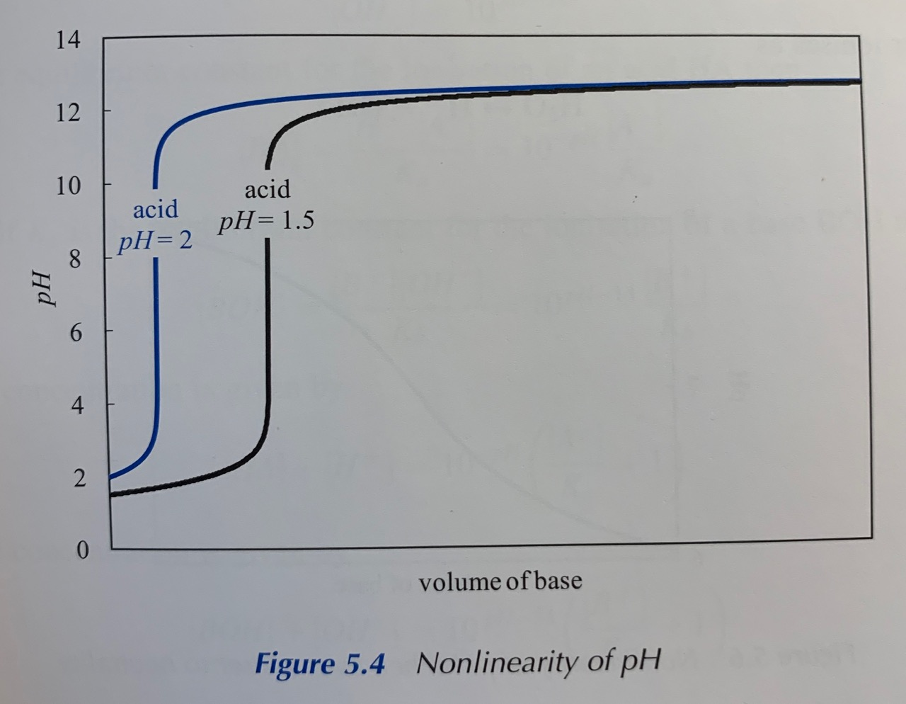
Process linearisation
compensating for nonlinear process behaviour
example control problem - pH
process gain varies from about 0.00013 to around 200
(10⁶ times larger than can be handled by a linear controller)
Notes:
Signal conditioning can be also applied to compensate for nonlinear process behaviour.
This graph shows curves of one strong base of pH 13, being titrated against a strong acid of pH 2, and against another of pH 1.5.
First, for a constant acid pH, over the whole operating range the process gain varies from a value of about 0.00013 to around 200, i.e. a factor about 106 times larger than can be handled by a linear controller. Second, if the flow of base is correct for neutrality (pH of 7) a change in the pH of the acid would cause a large change in the process gain.

Slide 6
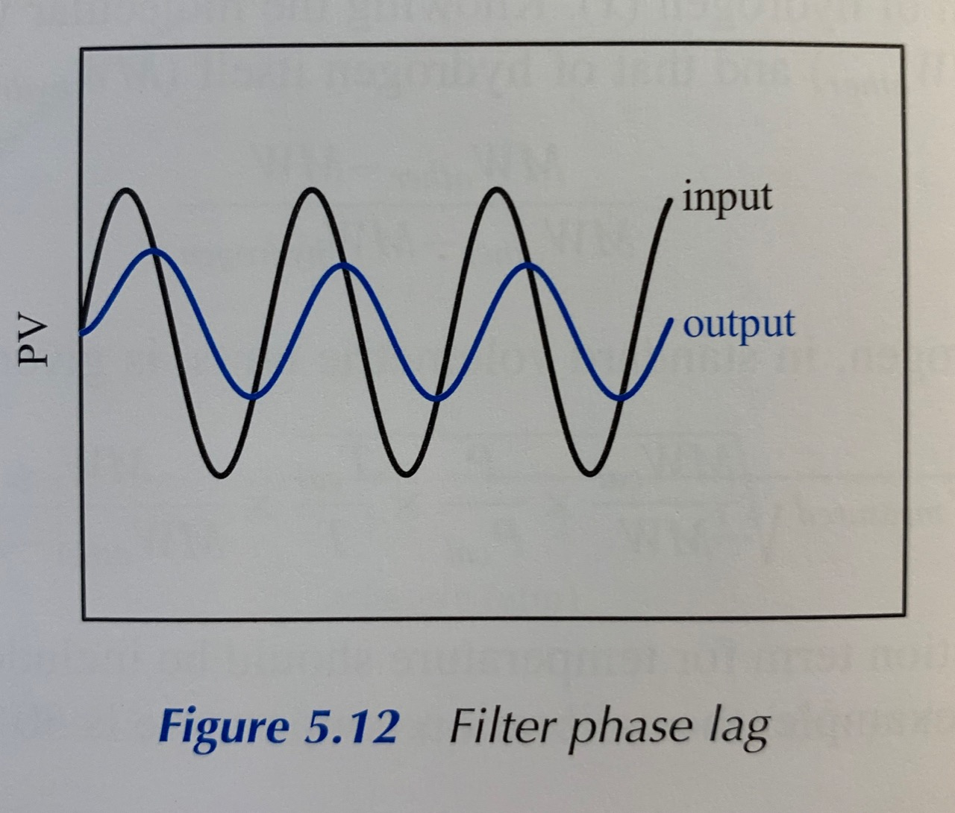
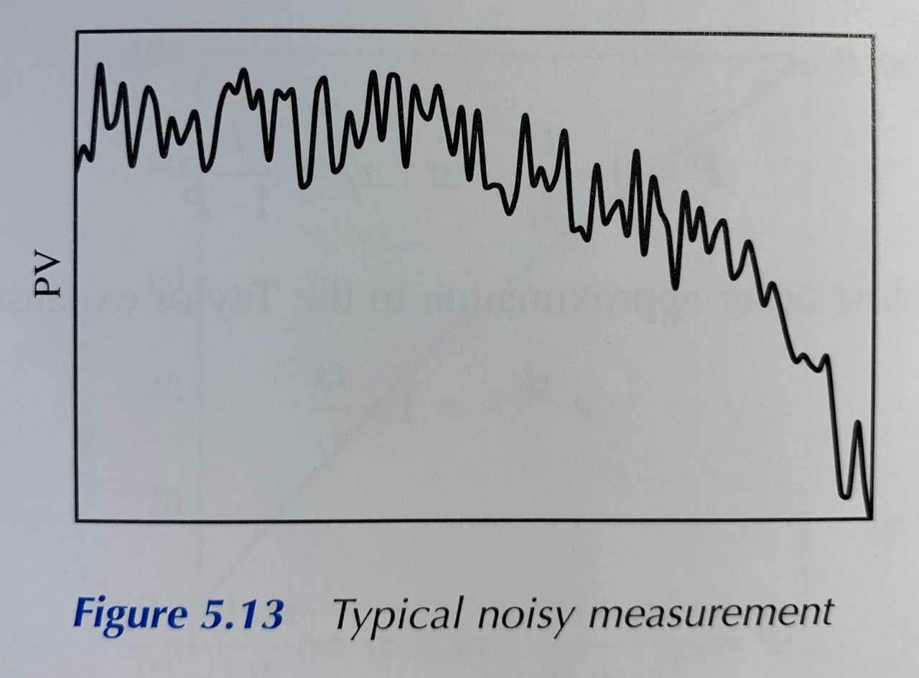
Filtering
reducing measurement noise
cause of the noise:
mechanical
electrical
Notes:
Another common form of signal conditioning is filtering - used to reduce measurement noise. Noise may be genuine in that the instrument is faithfully reproducing rapid fluctuations in the measurements. Example includes measuring the level of a turbulent liquid or a flow of a mixed phase fluid. Noise may be introduced mechanically by vibration or electrically through interference. While filtering may reduce the problem, it is unlikely to remove it completely and it will distort the base signal.
Whatever the cause, efforts should be made to eliminate the nose at source.
Filtering will change the apparent process dynamics, usually in a way detrimental to controller performance. If a sinusoidal signal is injected into a conventional filter then the output will be reduced in amplitude and shifted in time (as shown on graph).
Challenge is to remove the noise from the underlying base signal, without distorting it. There is a problem - it is not until well after the base signal has changed that the filter can recognise it. There will be a delay before the change is passed to the controller

